Slide 1
Data Mining Project Presented by: Amanraj Singh
DATS 6103
October 17, 2017

Slide 2
Objective
Describe military spending of atleast top 10 nations
Compare the data to that country’s GDP
Compare the data to the overall military spending of all the 10+ countries
Compare the per person military spending to the per person GDP
Single out the fastest growing countries in fixed value and in percentage

Slide 3
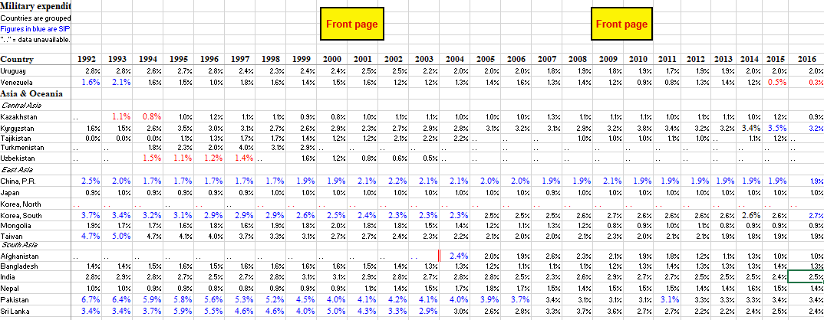
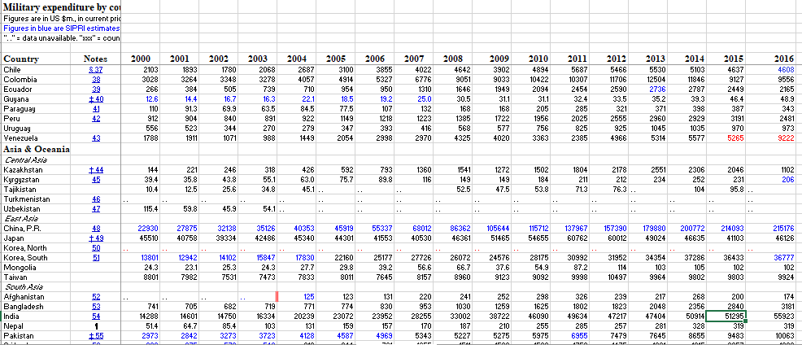
Initial Raw Data

Slide 4
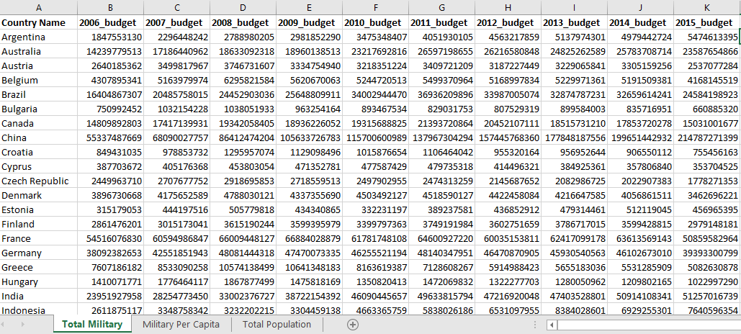
Formatted Data

Slide 5
Coding
Refer Jupyter Python Notebook

Slide 6
Observations and Results
Top 3 Countries in military spending
United States
UK
China
GDP vs Military comparison Top 3
Saudi Arabia
Russia
United States

Slide 7
Continued
Top 3 fastest growing Countries in military spending
China
Argentia
Saudi Arabia

